Slide 1

Gaining The Competitive Edge
M.Sc. Thesis 2021/2022 | Philipp Kläger

Slide 2
Table of Contents
Full Title
Gaining The Competitive Edge
Analyzing the Importance and Potential Success Drivers of Political Marketing Strategies Regarding the 2021 Federal Elections in Germany
Business Problem
Conceptual Model
Data
Results
4.1 Sentiment & Emotion Analysis
4.2 General Stance Analysis
4.3 Topic-Specific Stance Analysis
4.4 User-Generated Discussions
Discussion

Slide 3
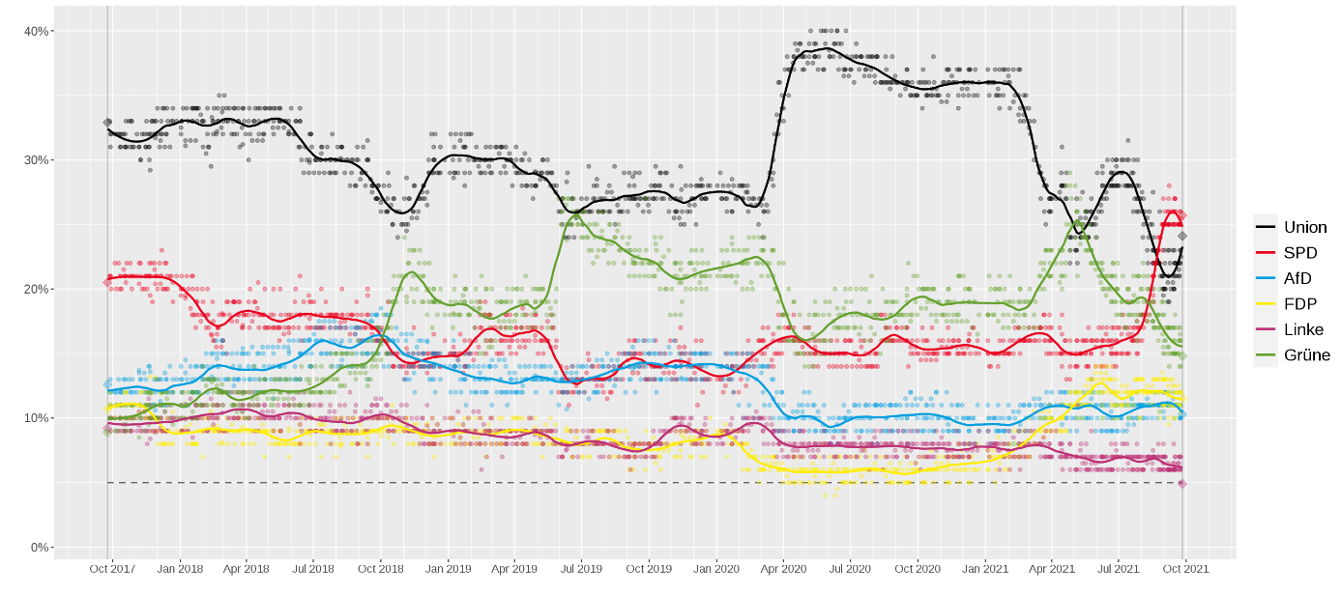
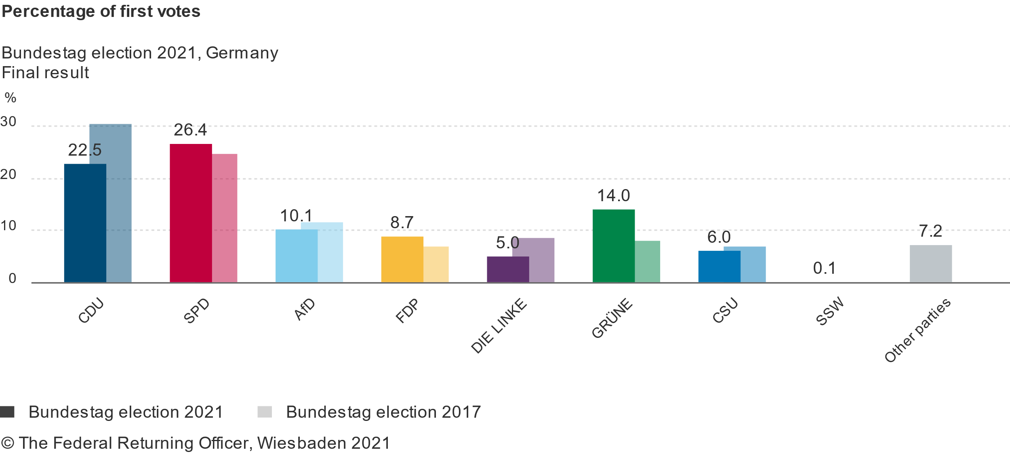
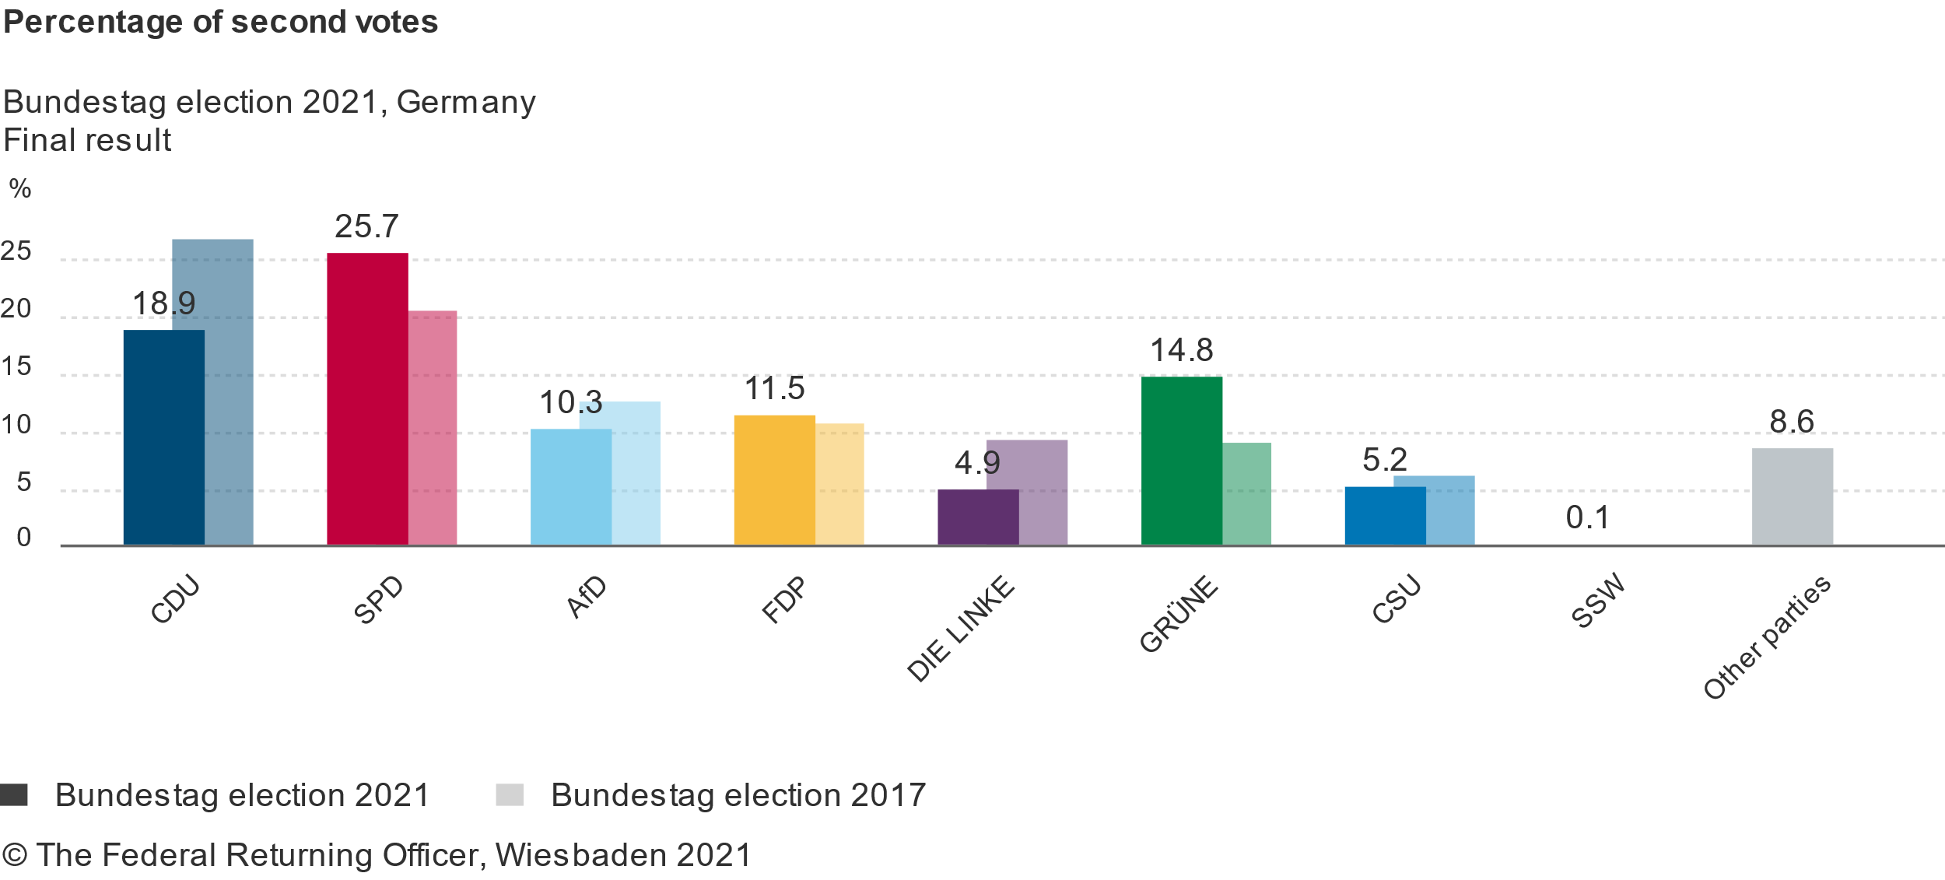
1. Business Problem
Research Question:
What are potential success drivers for the political marketing of the election and campaign winners (SPD & FDP) compared to the other parties (Union, Greens, AfD & Left)?
Note: Union = CDU + CSU
Marketing Implications:
→ provide data-driven suggestions for “successful“ political marketing regarding elections

Slide 4
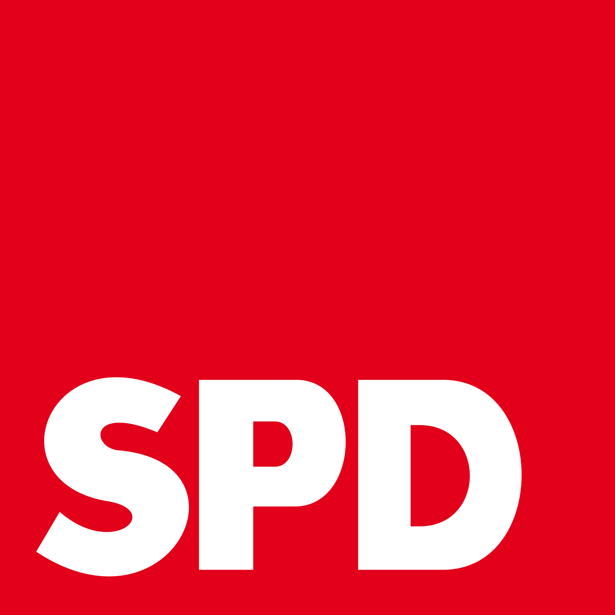

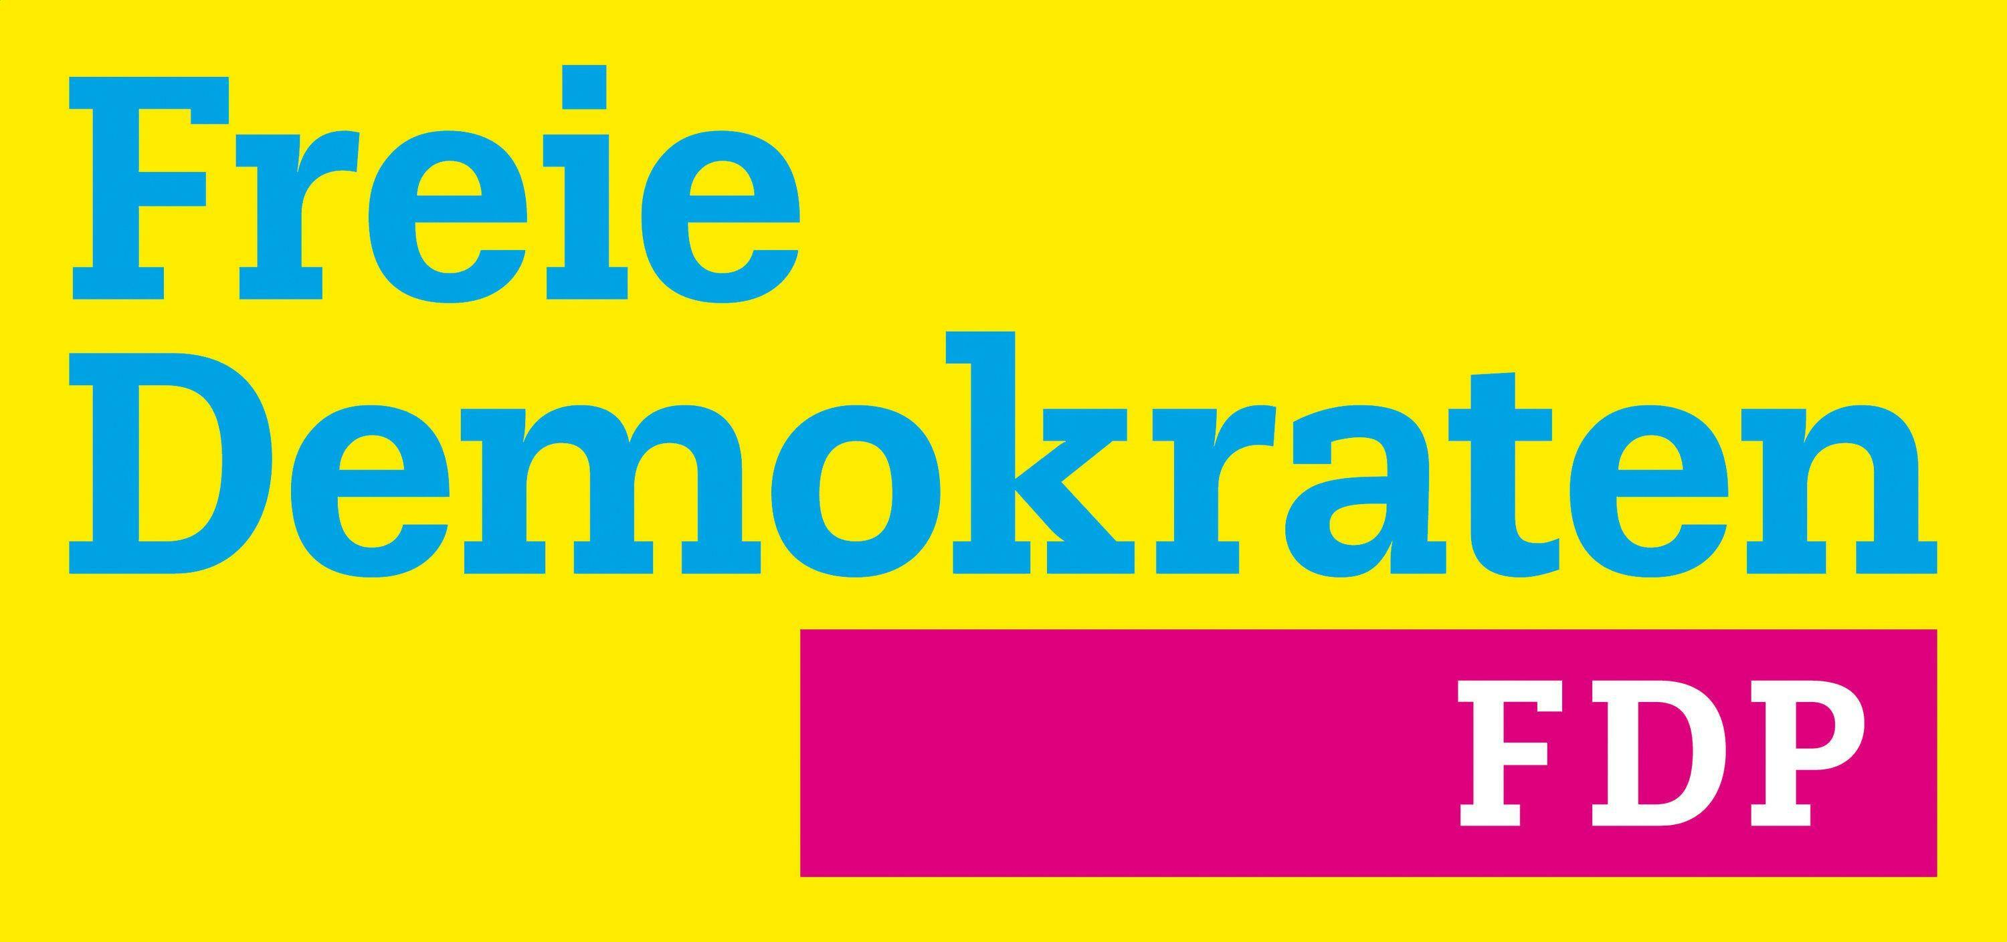
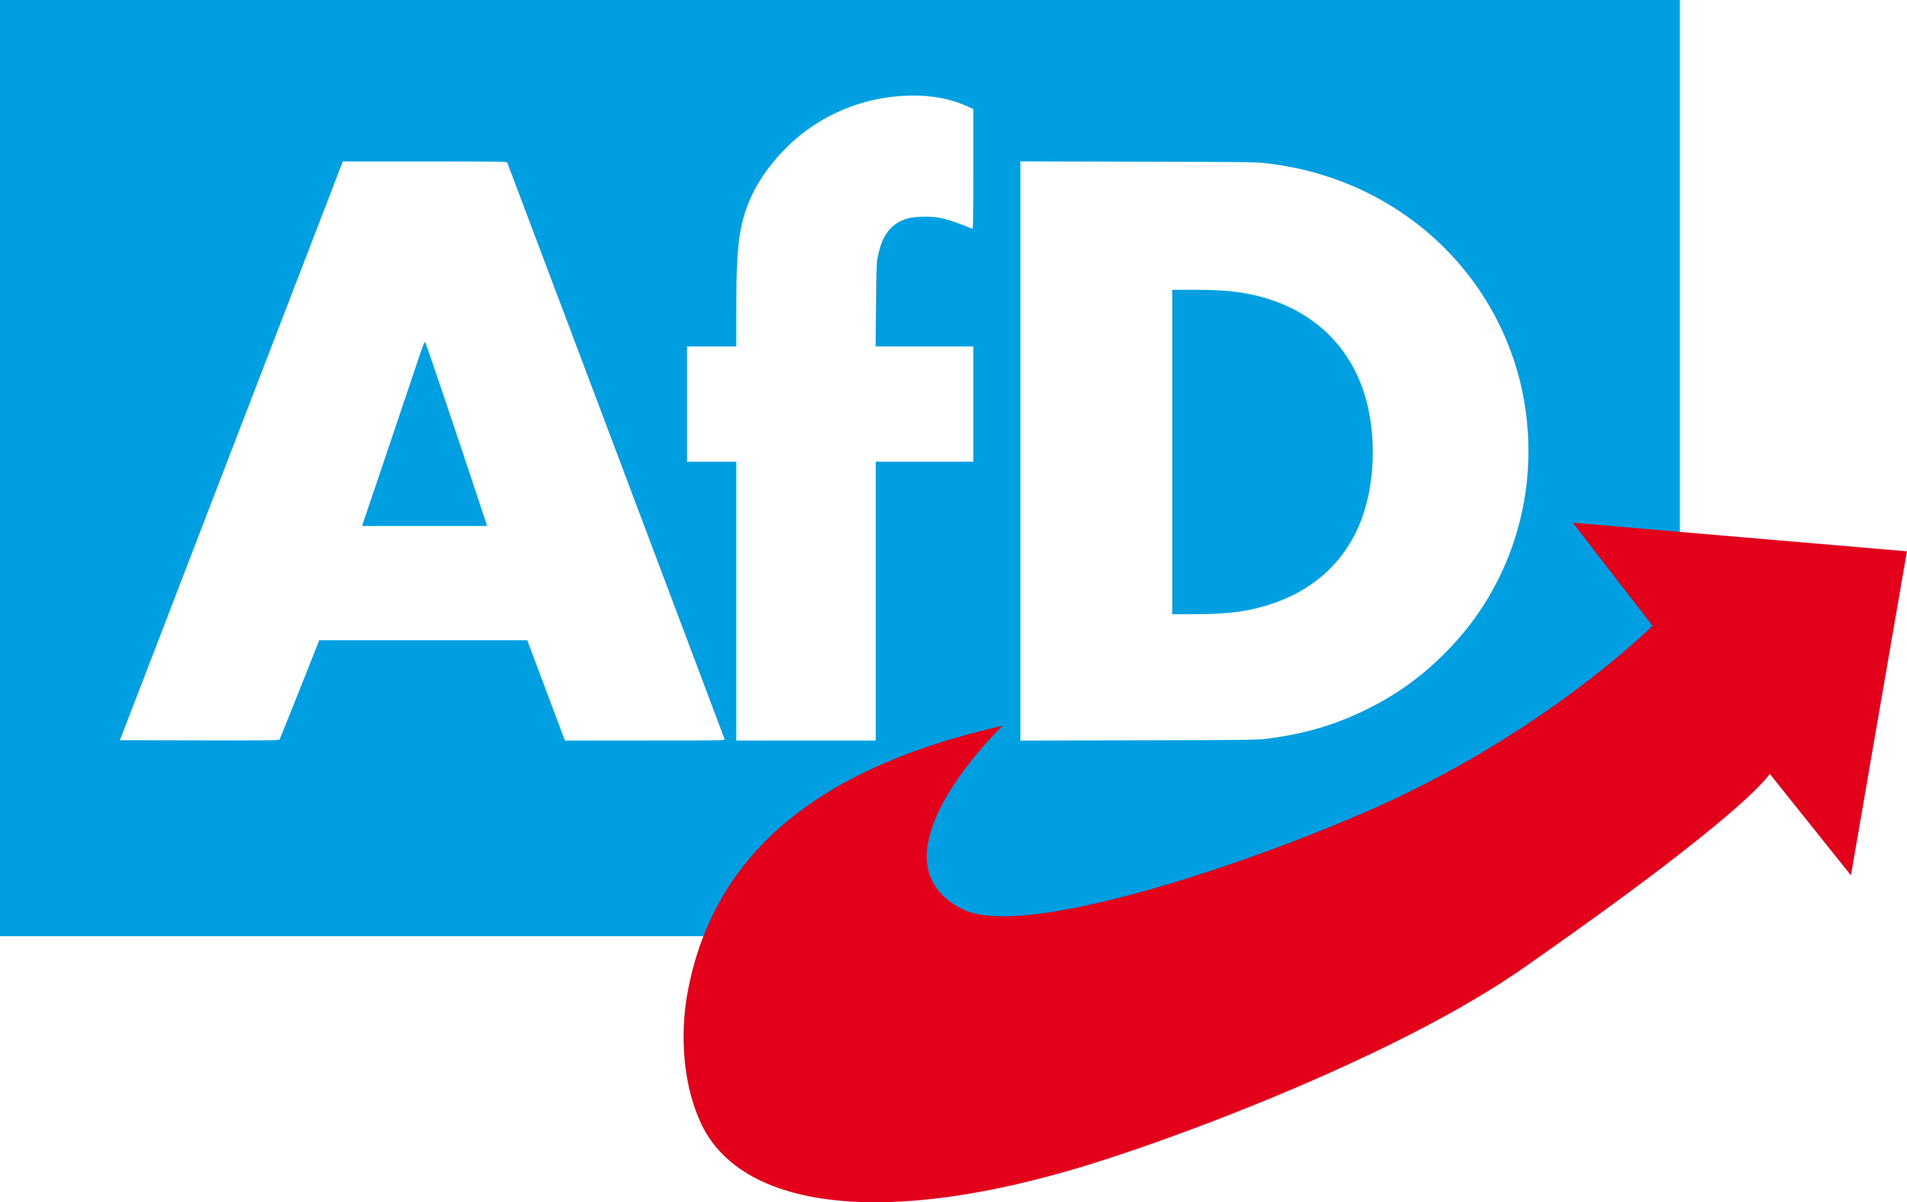


2. Conceptual Model
Research Question:
What are potential success drivers for the political marketing of the election and campaign winners (SPD & FDP) compared to the other parties (Union, Greens, AfD & Left)?
Data: party programs (2017+2021) + political marketing by the parties (Twitter, 2020-2021)
Party
Potential Success Drivers
6 Major Political Parties
Group 1 (++):
Successful
Group 2 (+-):
Partially Successful
Group 3 (--):
Unsuccessful
Party | SPD | CDU/CSU | Greens | FDP | AfD | Left
Election Result I September 24th 2017 | 20.5% | 33.0% | 8.9% | 10.7% | 12.6% | 9.2%
Campaign Start December 8th 2020 | 16.0% | 36.0% | 19.0% | 6.0% | 9.0% | 7.0%
Election Result II September 26th 2021 | 25.7% | 24.1% | 14.8% | 11.5% | 10.3% | 4.9%
Legislature Period Delta | +5.2% | -8.9% | +5.9% | +0.8% | -2.3% | -4.3%
Campaign Period Delta | +9.7% | -11.9% | -4.2% | +5.5% | +1.3% | -2.1%
Election Winners (→ new government) | yes | no | yes | yes | no | no
Campaign Winners (→ gained support during campaign term) | yes | no | no | yes | yes | no

Slide 5
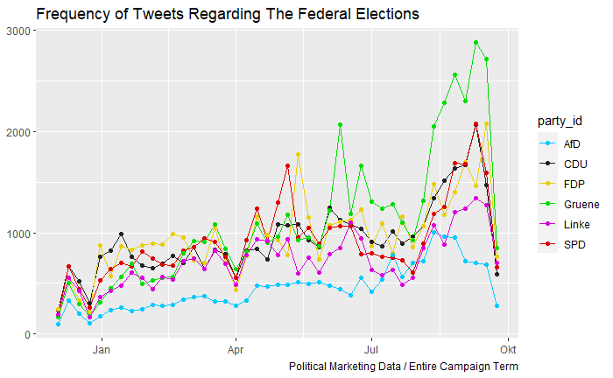
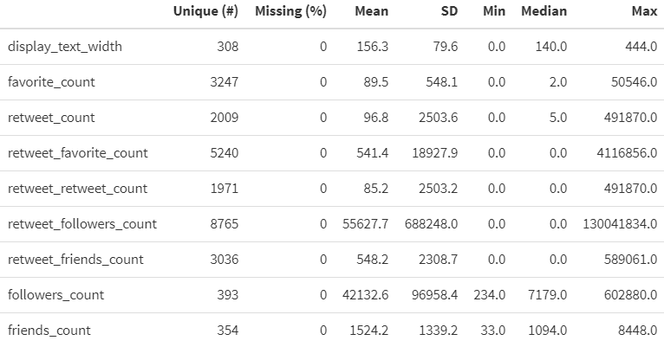
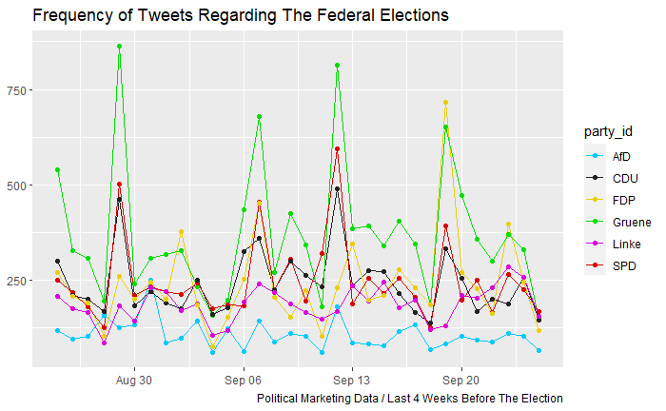
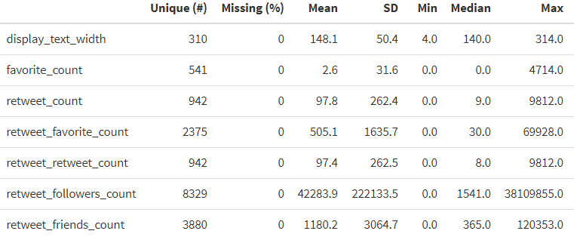
3. Data (I/II)
Data 1: Political Marketing (218,256 x 65)
Data 2: User-Generated Discussions (297,775 x 68)

Slide 6
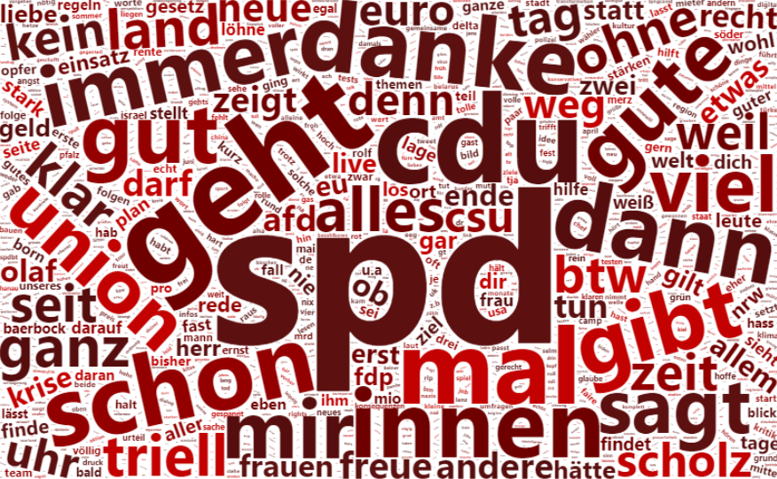
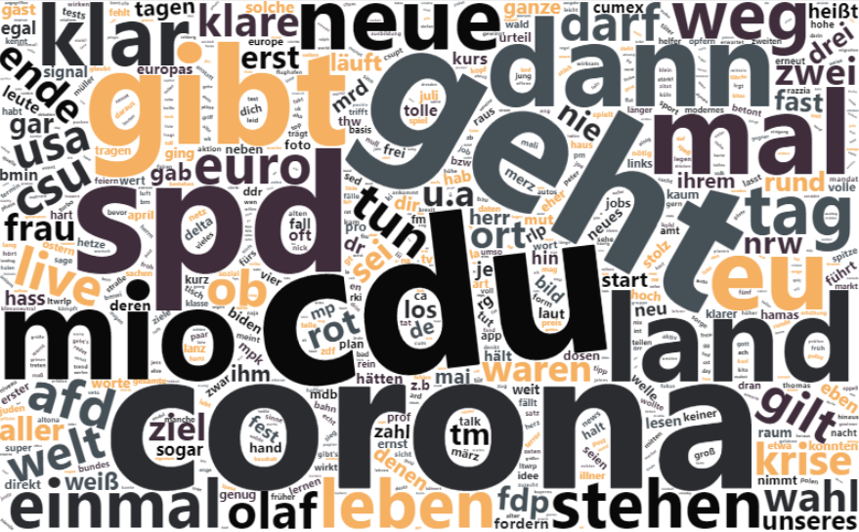
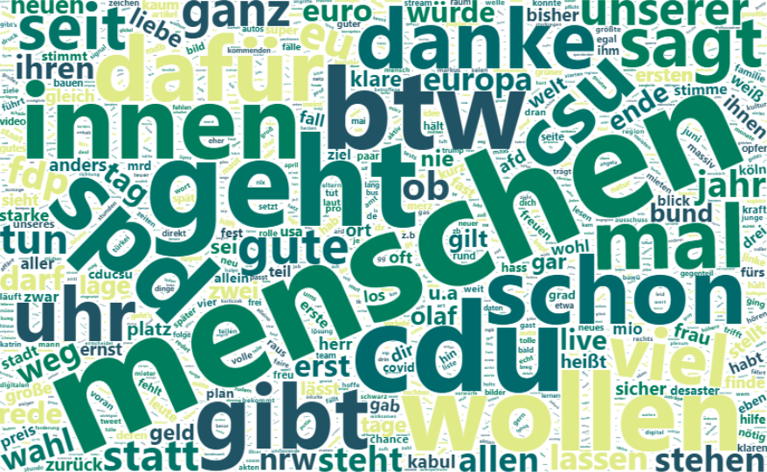
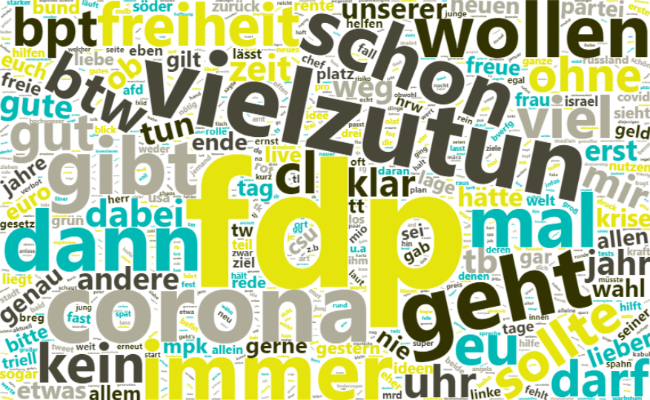
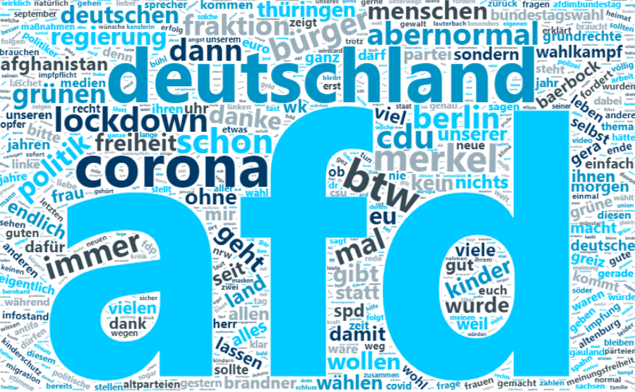
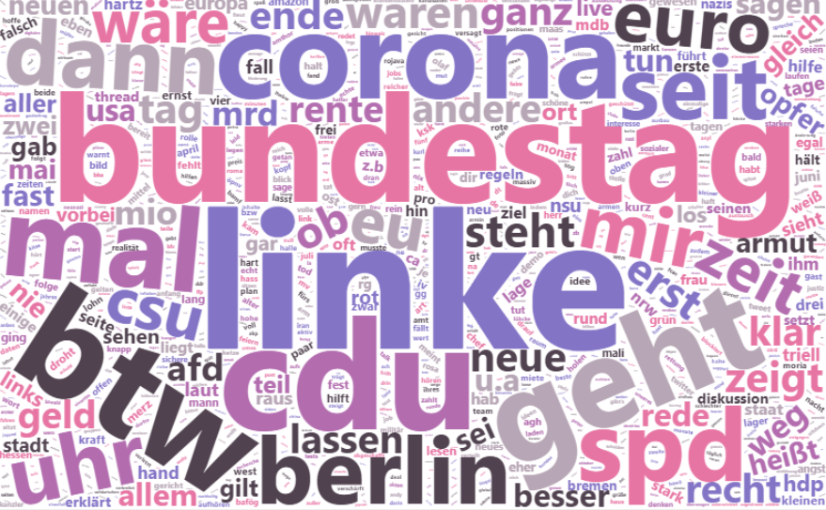
3. Data (II/II)
 | SPD | CDU | Greens | FDP | AfD | Left
Observations Total: 218,256 | 39435 | 40133 | 47116 | 41364 | 19361 | 30847
- Avg. Text Width | 149.30 | 151.39 | 153.11 | 152.85 | 167.88 | 173.52
- Avg. Favorite Count | 144.91 | 60.75 | 91.82 | 61.07 | 133.40 | 62.76
- Avg. Retweet Count | 85.89 | 83.26 | 138.33 | 74.47 | 107.26 | 88.03
- Avg. Followers Count | 62224.65 | 46932.89 | 44464.20 | 29245.91 | 23505.91 | 35611.61
- Avg. Friends Count | 1407.92 | 1305.86 | 2048.05 | 1768.77 | 945.58 | 1192.26
Tweet Contents
- Most Used Words | 1. spd (2987) 2. geht (1841) 3. cdu (1761) 4. menschen (1648) 5. mal (1505) 6. schon (1423) 7. danke (1393) 8. innen (1373) 9. dann (1354) 10. laschet (1250) | 1. deutschland (2166) 2. cdu (1974) 3. corona (1899) 4. geht (1743) 5. menschen (1699) 6. spd (1557) 7. wollen (1423) 8. danke (1351) 9. gibt (1285) 10. mio (1251) | 1. klimaschutz (3617) 2. menschen (2728) 3. geht (2208) 4. cdu (2201) 5. btw (1994) 6. laschet (1985) 7. bundesregierung (1923) 8. wollen (1915) 9. bundestag (1899) 10. innen (1856) | 1. fdp (3225) 2. vielzutun (1924) 3. corona (1852) 4. deutschland (1688) 5. geht (1654) 6. menschen (1638) 7. dann (1551) 8. immer (1514) 9. schon (1488) 10. gibt (1461) | 1. afd (7674) 2. deutschland (1619) 3. bundestag (1564) 4. corona (1301) 5. btw (925) 6. deutschlandabernormal (842) 7. merkel (830) 8. kinderkongress (793) 9. schon (758) 10. cdu (735) | 1. menschen (2137) 2. linke (1838) 3. bundesregierung (1493) 4. cdu (1461) 5. bundestag (1439) 6. btw (1361) 7. geht (1254) 8. corona (1206) 9. deutschland (1173) 10. gibt (1127)
Dominant topics:
Corona pandemic + environment

Slide 7
4. Results Quick Intro / Expectations
1. Party Orientation (left-to-right)
left-wing oriented
right-wing oriented
2. Tweet Orientation ≠ Program Orientation
due to heterogeneity and different personal stances
3. Use of Sentiments & Emotions
the more radical, the more sentiments and emotions

Slide 8
4.1 Sentiment & Emotion Analysis
lowest value | highest value
 | SPD | CDU/CSU | Greens | FDP | AfD | Left
Sentiment Index | -0.6251 | -0.6292 | -0.6772 | -0.6981 | -0.7347 | -0.8205
- Syuzhet Algorithm | -0.3347 | -0.3290 | -0.3581 | -0.3676 | -0.3954 | -0.4432
- Bing Algorithm | -0.3985 | -0.4065 | -0.4445 | -0.4685 | -0.4910 | -0.5385
- Afinn Algorithm | -1.2819 | -1.3075 | -1.3779 | -1.3992 | -1.4697 | -1.6497
- NRC Algorithm | -0.4852 | -0.4737 | -0.5283 | -0.5572 | -0.5829 | -0.6505
- Positive | 0.4527 | 0.4282 | 0.4083 | 0.4166 | 0.3481 | 0.3860
- Negative | 0.2698 | 0.2744 | 0.3026 | 0.3178 | 0.3217 | 0.3306
Intensity Index | 0.8844 | 0.8871 | 0.8876 | 0.8703 | 0.8840 | 0.9238
- Anger | 0.0618 | 0.0611 | 0.0729 | 0.0699 | 0.0866 | 0.0764
- Anticipation | 0.1488 | 0.1496 | 0.1437 | 0.1379 | 0.1370 | 0.1565
- Disgust | 0.0376 | 0.0369 | 0.0418 | 0.0395 | 0.0544 | 0.0461
- Fear | 0.0979 | 0.0989 | 0.1056 | 0.1031 | 0.1189 | 0.1156
- Joy | 0.1041 | 0.1107 | 0.0969 | 0.0958 | 0.0843 | 0.1041
- Sadness | 0.1374 | 0.1458 | 0.1552 | 0.1574 | 0.1705 | 0.1744
- Surprise | 0.0728 | 0.0666 | 0.0679 | 0.0687 | 0.0553 | 0.0566
- Trust | 0.2168 | 0.2174 | 0.1940 | 0.1981 | 0.1769 | 0.1940
Old Government
Old Opposition
Takeaways:
Sentiments: the SPD and CDU/CSU have held the most positively connoted campaign efforts, whereas the Left has issued the most negatively oriented tweets
Emotions I: per tweet on avg., the Left has the highest sum of all emotion scores, indicating that their campaign has the highest usage of emotions in their tweets
Emotions II: per tweet on avg., as expected, the AfD has the highest scores for anger, disgust and fear; providing further empirical evidence for their image as agitators

Slide 9
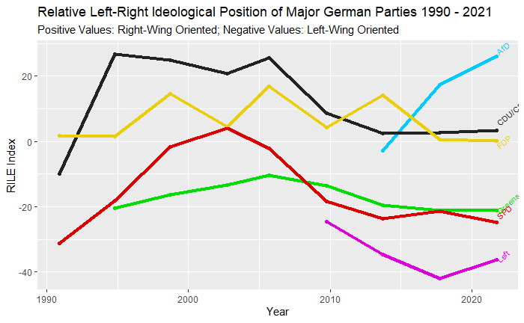
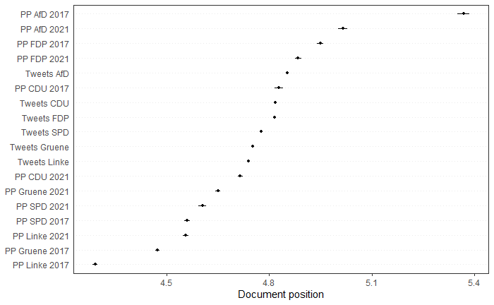
4.2 General Stance Analysis
Party Programs Range (2017)
Party Programs Range (2021)
Party Tweets Range (2021)
“Battle For
The Middle”?
ManifestoR RILE Index
relative position of parties (1990-2021) based on ideological positions of their programs
Quanteda WordScores
relative postion of party programs (2017 & 2021) + tweets (2021); based on expert evaluations and wordscore predictions
Takeaways:
RILE vs. WordScores: all 2021 programs use more similar wordings than their 2017 predecessors (closer relative position towards the middle); the tweets display the highest proximity in WordScores, indicating a high degree of linguistic similarity
Paradoxon AfD: while their 2021 program indicates a fortified right-wing position, the wordscores for this year’s program and tweets indicates the usage of less radical language

Slide 10
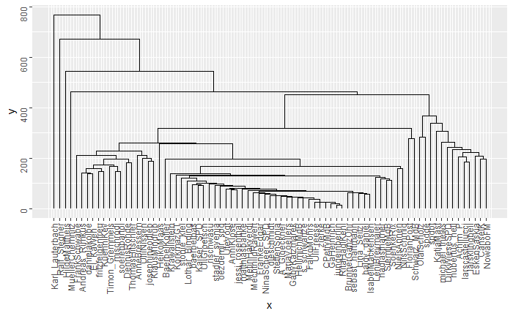
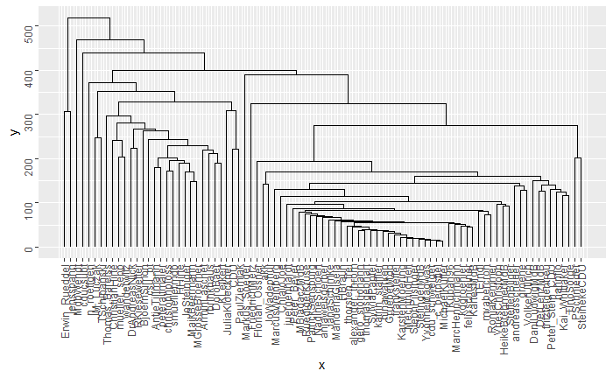
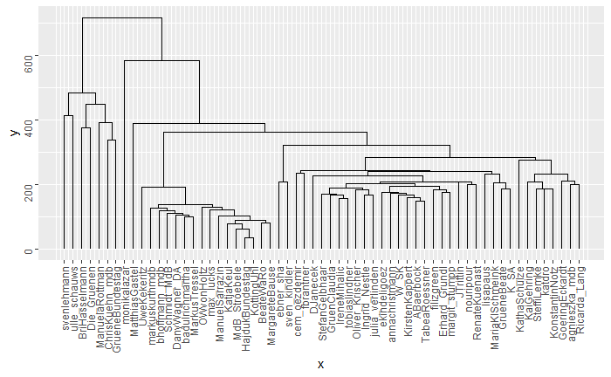
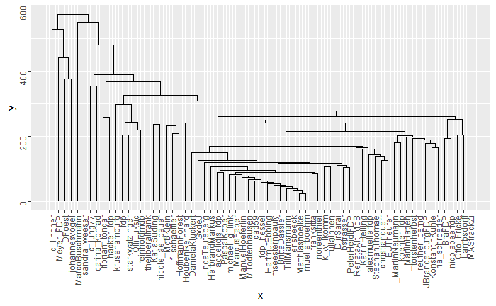
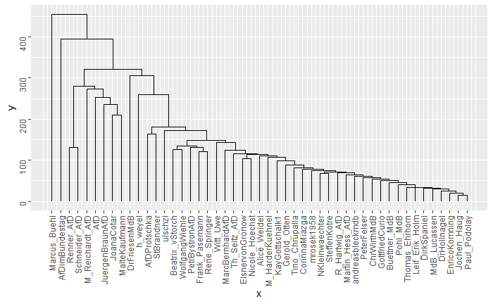
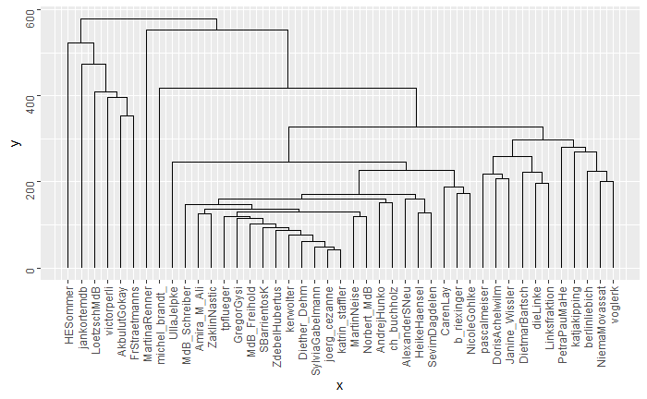
4.2 General Stance Analysis
lowest value | highest value
Similarity Between Authors (SBA)
Party | SPD | CDU | Greens | FDP | AfD | Left
Median Distance | 196.60 | 202.20 | 233.52 | 222.94 | 145.30 | 257.82
Mean Distance | 219.40 | 209.23 | 270.75 | 242.75 | 176.66 | 281.75
IQR Distance | 137.10 | 166.89 | 137.10 | 124.05 | 167.02 | 180.06
SBA Dendrograms
Lexical Diversity
Party | SPD | CDU | Greens | FDP | AfD | Left
PP 2017 | 0.4622 | 0.4392 | 0.3959 | 0.4728 | 0.6152 | 0.5036
PP 2021 | 0.4905 | 0.3969 | 0.4087 | 0.4960 | 0.6035 | 0.4686
T 2021 | 0.1279 | 0.1200 | 0.1047 | 0.1181 | 0.1619 | 0.1222
Takeaways:
Similarity Between Authors: as expected, the AfD displays the highest congruence between accounts, whereas the Left has the lowest similarity between authors
Lexical Diversity: unexpectedly, the AfD also have the highest lexical diversity in their tweets. This might be due to their tendency to create new words for specific situations (“Coronadiktatur”)

Slide 11
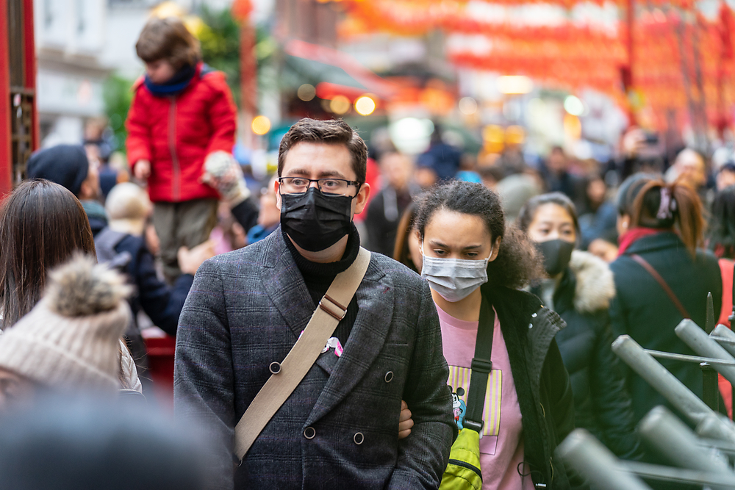
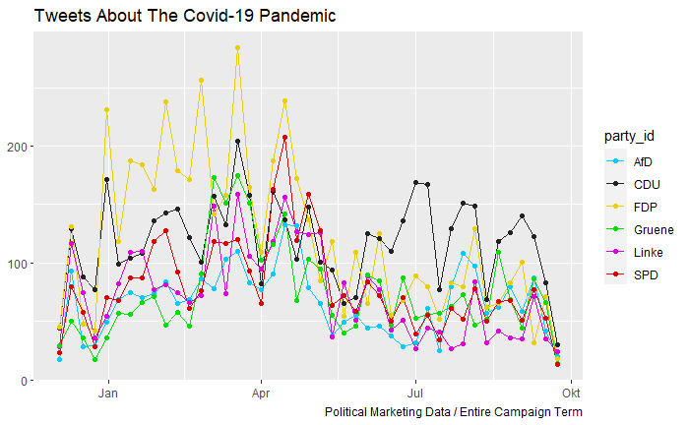
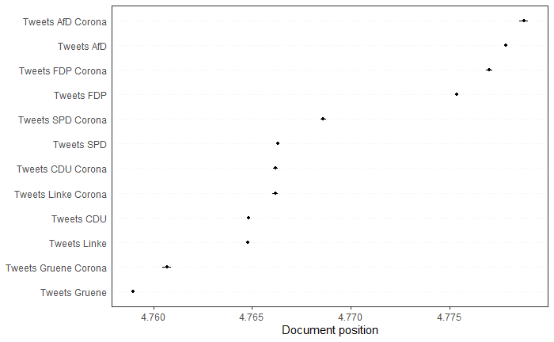
4.3 Topic-Specific Stance Analysis Topic 1/3: Corona / Covid-19 pandemic
Shift to the right: FDP and AfD as trendsetters?
Two Phases: Lockdown vs. Non-Lockdown
“Hard“ Lockdown II
Takeaways:
Shift to the right: the stances of corona-specific tweets are positioned more right-wing than the overall tweet stance scores for all parties
While AfD and FDP are the front-runners in the right-wing shift with the most radical positions, the SPD displays the highest deviation between their overall and their corona-specific stance
Surprisingly, CDU and the Left have a very similar overall and corona-specific positioning, indicating that they utilize a congruent language

Slide 12
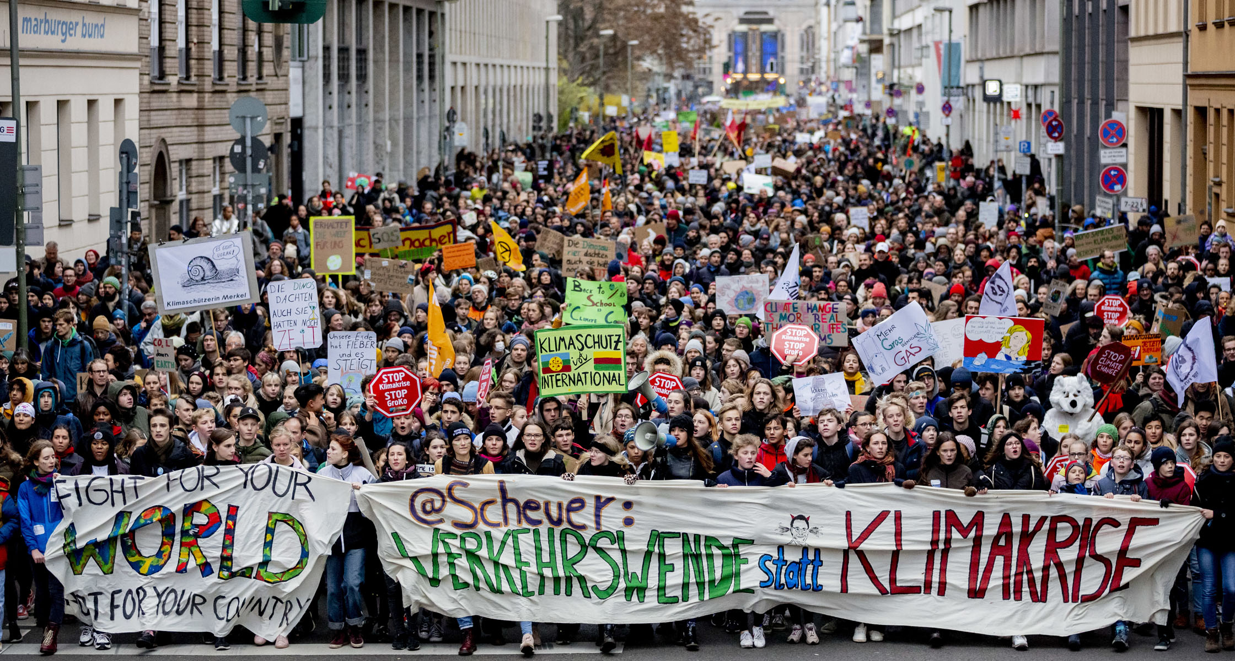
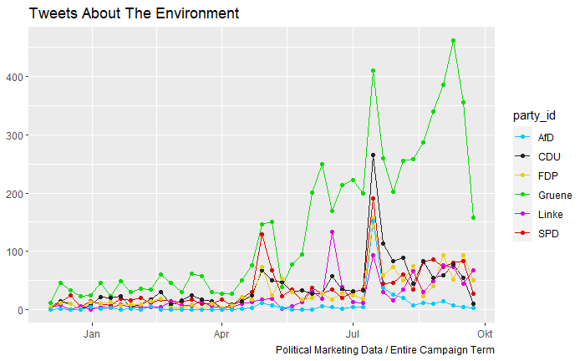
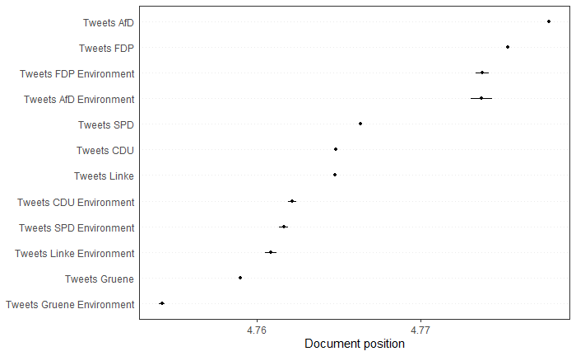
4.3 Topic-Specific Stance Analysis Topic 2/3: Environment / Climate Change
Shift to the left: Greens as trendsetters?
Floods
July Spike: floods in West Germany (“Jahrhundert-hochwasser 2021”)
“Hard“ Lockdown II
Takeaways:
Shift to the left: the stances of environment-specific tweets are positioned more left-wing than the overall tweet stance scores for all parties
The Floods in Germany have caused a drastic short-term increase in posts about climate change; except for the Greens who used this to amplify their efforts even more, the other 5 parties quickly withdrew their attention from the topic after the event

Slide 13

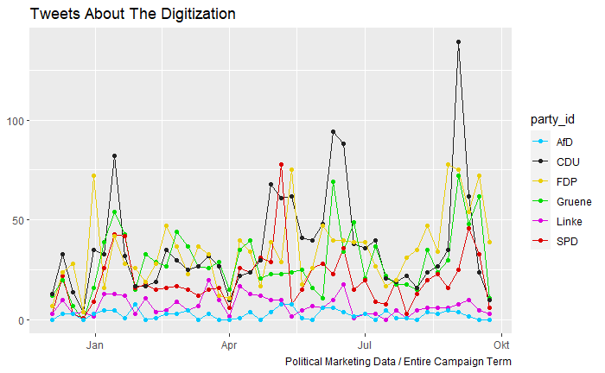
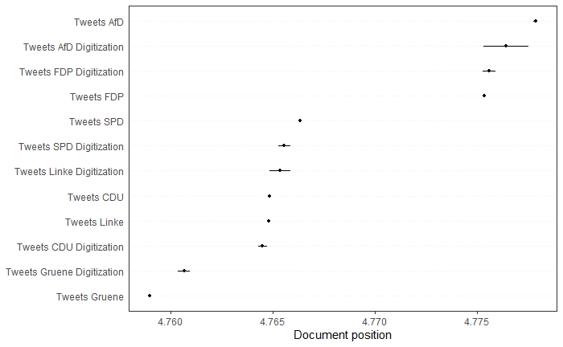
4.3 Topic-Specific Stance Analysis Topic 3/3: Digitization
Polarizing shifts: Left-Shift (CDU, SPD & AfD) vs. Right-Shift (FDP, Left & Greens)?
Spikes: campaign offensives or event-related?
“Hard“ Lockdown II
Takeaways:
As expected, the FDP are the leaders of one stance group, as they heavily highlighted this topic in their campaign efforts
Surprisingly, the CDU is the frontrunner of the other group, even though they have been criticized for their lack of progress in this area in the last 16 years of government
Another surprise is the groups themselves, as these parties are usually not seen in the same context in the public eye

Slide 14
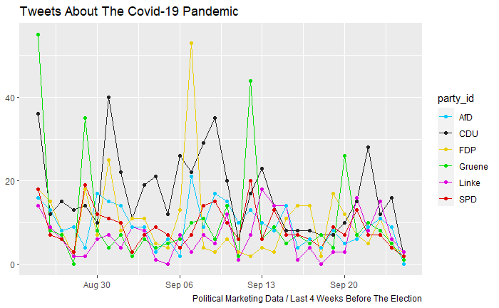
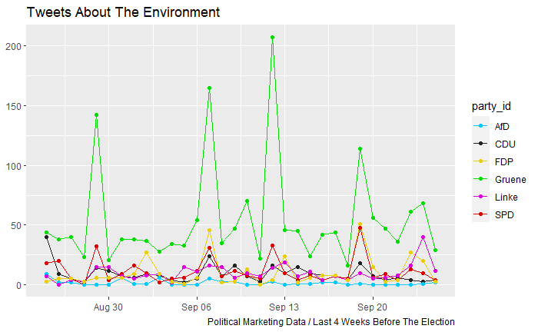
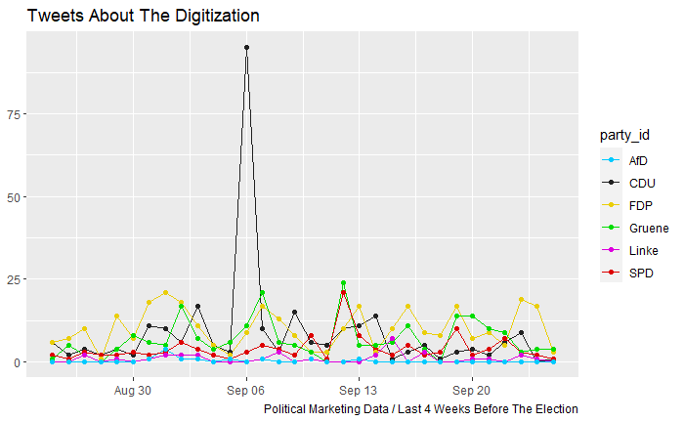
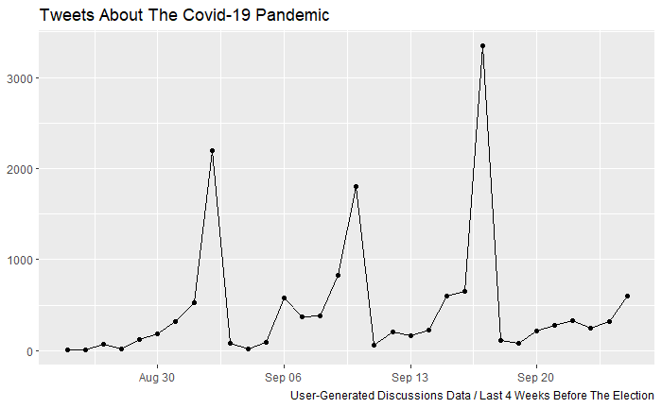
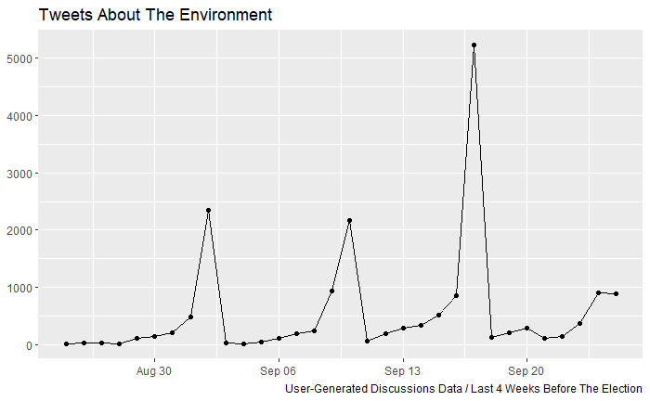
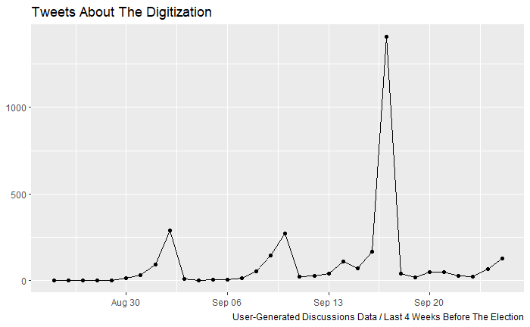
4.4 User-Generated Discussions
???
Marketing Side
→ no visible connection between the volume of both sides
User Side

Slide 15
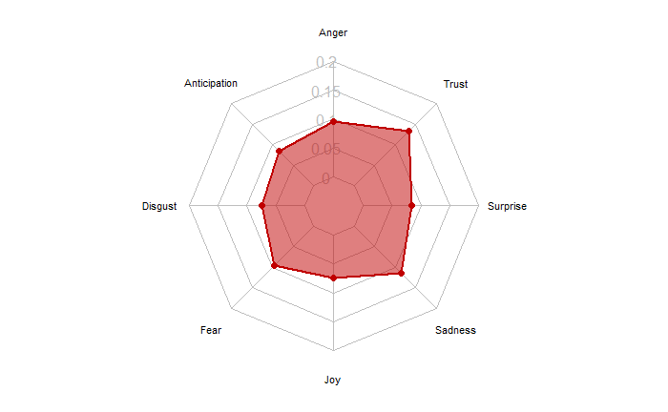
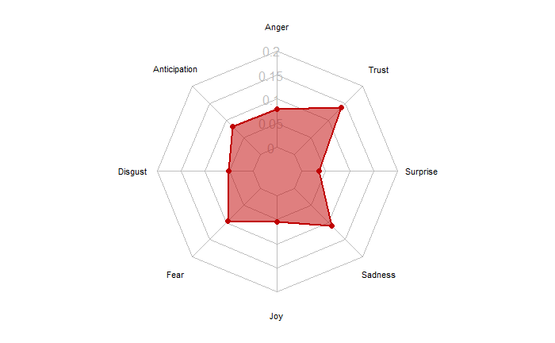
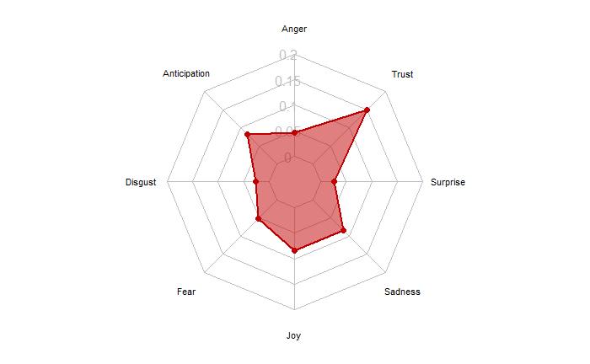
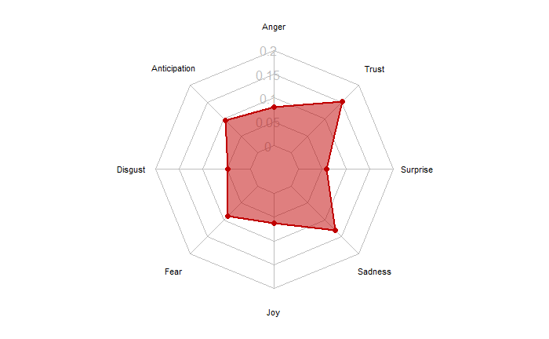
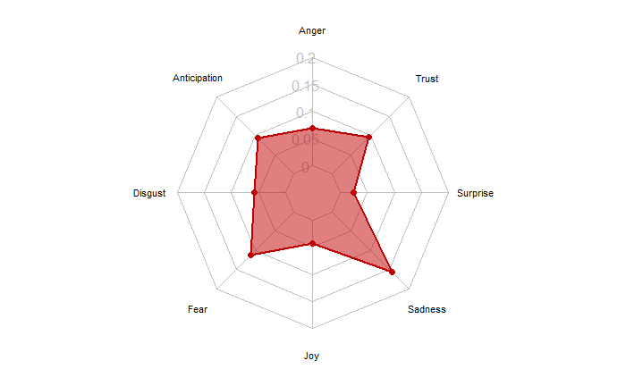
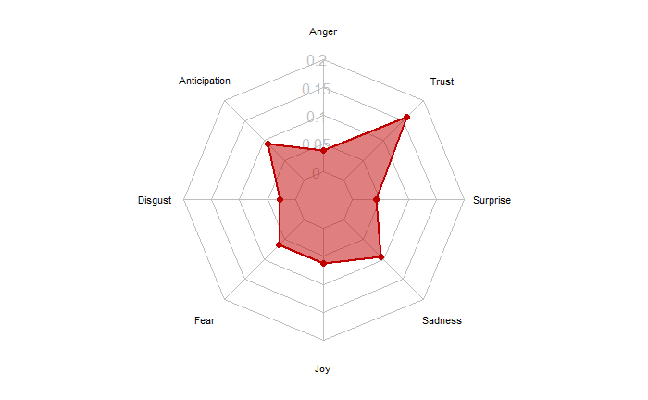
4.4 User-Generated Discussions
Maximum Value
Minimum Value
For each emotion in the entire data set
Public Party Images:
SPD with highest values in 3 emotions, while Greens (4) and AfD (3) have the lowest value in as many emotions
Similar Perceptions
Group 1 – CDU & FDP
Group 2 – Greens & Left
SPD and AfD unique
Congruene with Emotions in Marketing?
→ Congruence Plot still in work

Slide 16
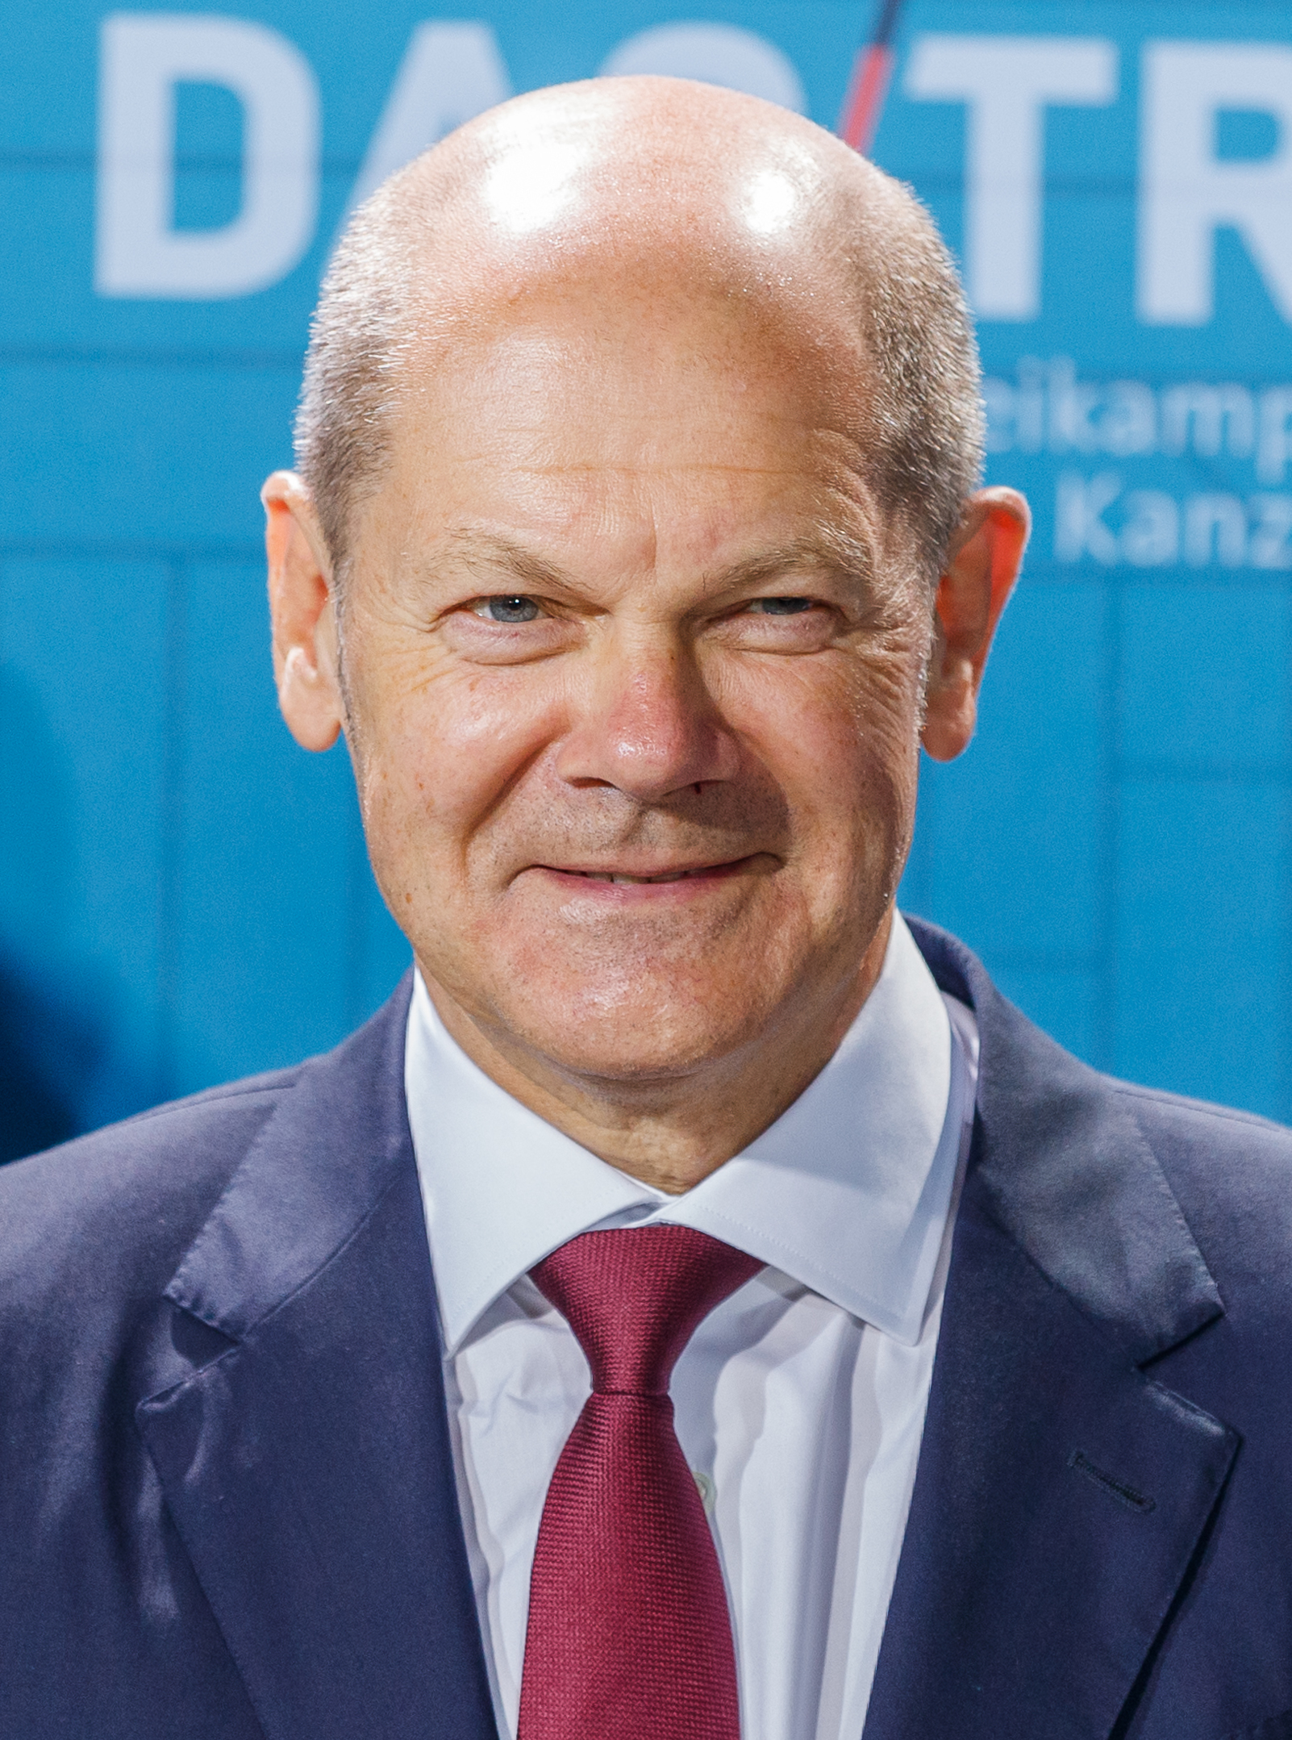
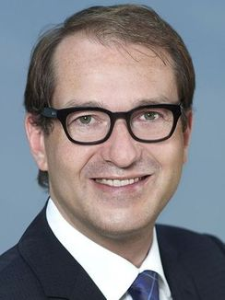
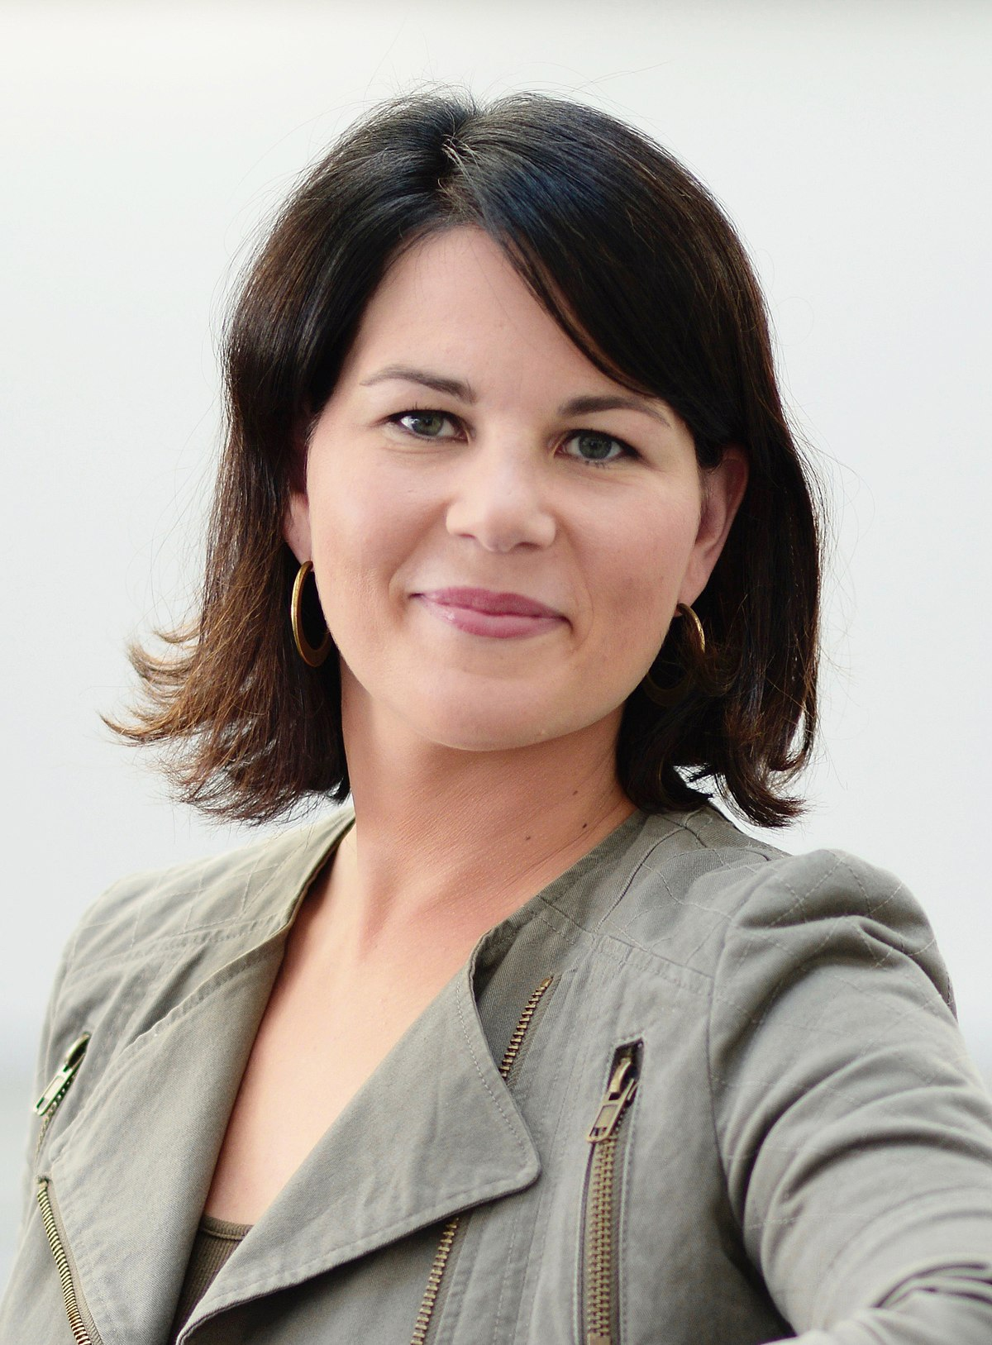
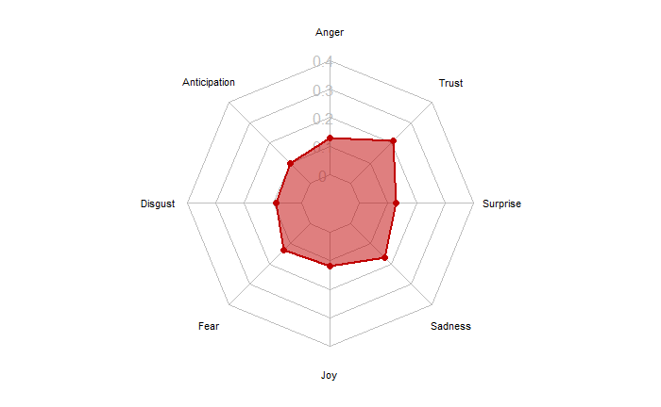
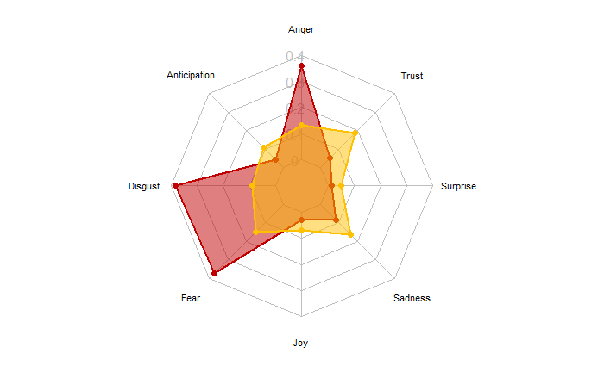
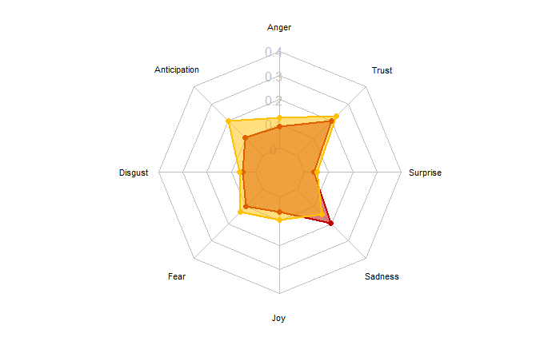










4.4 User-Generated Discussions
Maximum Value
Minimum Value
For each emotion in the entire data set
Public Candidate Images:
Similar pattern: Olaf Scholz (SPD) and Christian Lindner (FDP) both induce few negative emotions and a high volume of ‘trust’
Alexander Dobrindt (CSU) draws high levels of ‘disgust’ and ‘fear’, indicating a very negative public perception
Surprisingly, the AfD candidates have low values for emotions across the board, even in categories that they were leading in their marketing efforts (anger, disgust & fear)
Olaf Scholz
Alexander Dobrindt
Annalena Baerbock
Armin Laschet
Robert Habeck
Christian Lindner
Tino Chrupalla
Dietmar Bartsch
Alice Weidel
Janine Wissler

Slide 17
5. Discussion (I/II)
Potential Success Drivers (SPD & FDP):
Reach & Interactions: shortest tweet texts + highest interaction figure in terms of favorite and follower counts + most posts without hashtag (58.39%) (SPD)
Sentiments: most positively connoted tweet texts (SPD)
Emotions: highest usage of the emotion ‘surprise’ in tweet texts (SPD) + lowest overall emotion intensity in tweet texts (FDP)
Topics & Stances: leading the way for other parties in the topics of Corona and digitization (FDP)
User-Generated Discussions & Public Images: induce low levels for ‘disgust’ and ‘fear’ and high levels for ‘trust’ and ‘surprise’ (SPD+FDP) + most positively connoted tweets about lead candidate (FDP)
Big Topics (Corona, environment & digitization): responsive relationship between tweet volume and relevant events for the major issues of the election campaign (e.g., lockdown vs. non-lockdown, July floods) is evident. As expected, the Greens were the drivers for the topic environment, yet surprisingly, the CDU/CSU lead the way for the topic digitization along the FDP.

Slide 18
5. Discussion (II/II)
Consolidating Literature Review with Analysis Results:
Hate speech decreases the exercised freedom of expression on the internet, subsequently reducing the diversity of opinions and shifting the perceived position of the majority opinion in political discussions. Vast majority of hate-speech creating accounts on social media can be linked to AfD and Identarian Movement (Geschke et. al. 2019 & Kreißel et. Al. 2018). This strategy is also evident in the used emotions in the AfD tweets.
even though Laschet (CDU) was the target of situational contingency (e.g., #laschetdarfnichtkanzlerwerden), sister party candidate Dobrindt (CSU) was perceived considerably worse in the public eye.
Marketing Implications:
Gaining the competitive edge: substantial amount of voters are susceptible to persuasion by the means of political marketing, as 23% of polled German voters were uncertain of their voting decision two weeks before the election (Spiegel 2021), pattern of 10-20% of undecided voters two weeks before election is also empirically established in Italy and France (Alam & Riva 2019, La Repubblica 2006 & Mannheimer 2003)
Keep it simple and easy to understand: WordScore results display a converging assimilation of the used language across parties from 2017 to 2021. Given the election results and analysis implications of the AfD in 2021, their displayed high level of lexical diversity does not translate into a better interaction rate or better electoral results. In accordance with this, multiple parties have started to offer their party programs in easy language for the 2021 federal elections.
Epistemic Value: induce curiosity with marketing activities! Short, positively connoted tweets with surprising elements work best for electoral political marketing
Dissemination: usage of hashtags is not or no longer needed for political discussions on Twitter?

Slide 19
Thank You For Your Time!

Slide 20


Slide 21


